Slide 1
Eye Tracker Comparison Study:
Pupillabs vs. Eyelink
Groß, Ehinger, Ibs & König
Notes:
Hi
.
I am really excited to give you a quick update
on the etcomp project and present results of
some selected conditions today.
.
I think this project is really important as we work a lot with eye trackers here in the nbp.
.
.
Let‘s jump right into it:
.
Talk about good and bad accuracy (not high and low)

Slide 2
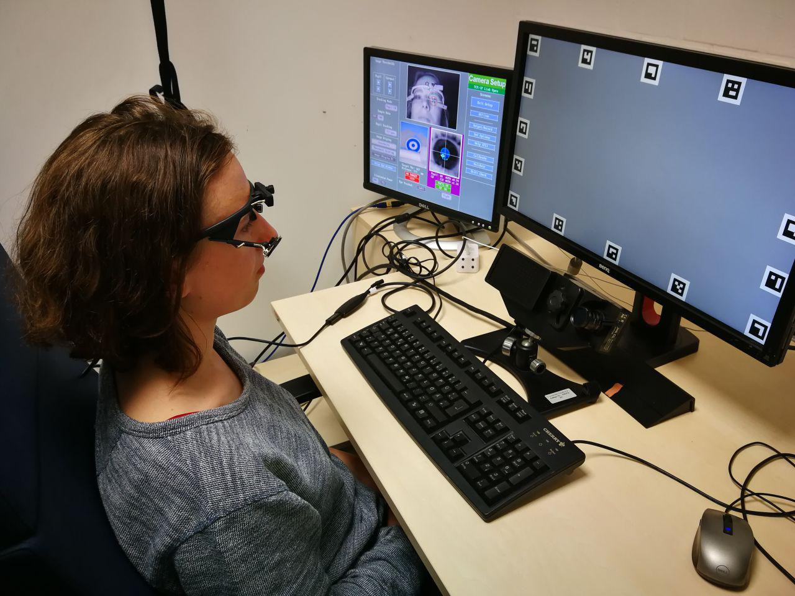
Experimental Setup
Notes:
So here you you can see the experimental set up
.
- Thank you to Susanne for allowing me to take this picture.

Slide 3
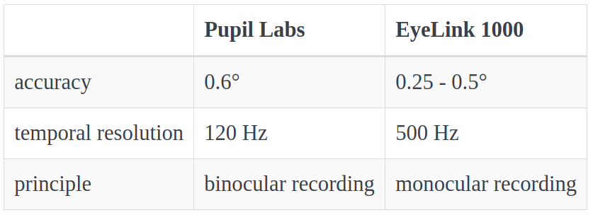
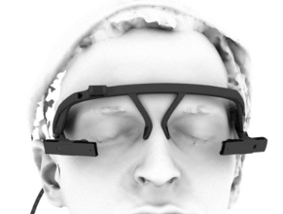
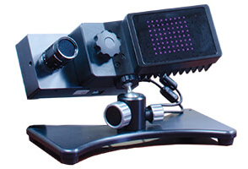
Pupillabs (PL) vs. Eyelink (EL)
- values reported from manufacturers^{1, 2} -
Notes:
What leads us to this project is that eye tracking data quality is really important for our research results.
.
The manufacturers promise the following:
.
Degree of visual angle is related to the size that the stimulus subtends on the retina.
.
But the research on really testing the accuracy and precision of eye trackers is sparse.
.
So this is why a project like etcomp can make an important contribution:
.
We were especially interested in the accuracy of the eyetrackers as the detected fixation location is of major importance for many eye tracking experiments.
.

Slide 4
Data Preprocessing
We developed a flexible Pipeline: Business as usual!
parse messages and combine with gaze data
convert units of measures
explore raw data samples
apply blink and saccade detection algorithms
    ¬ blink & ¬ saccade = fixation
Notes:
- message that were sent during the experiment (line up with recorded data)
.
- pupil diameter to pupil area; pixel to visual angle
.
- data exploration also as sanity check
.
.
- blink detection (integrated in EyeLink)
.
- for my thesis I only used one event detection algorithm which is the velocity based saccade detection alg from Engbert and Mergenthaler.
.
- all samples that neither belong to a blink nor to a saccade, are classified as fixations
.
But our pipeline is flexible and build with the vision to analyze different algorithms

Slide 5
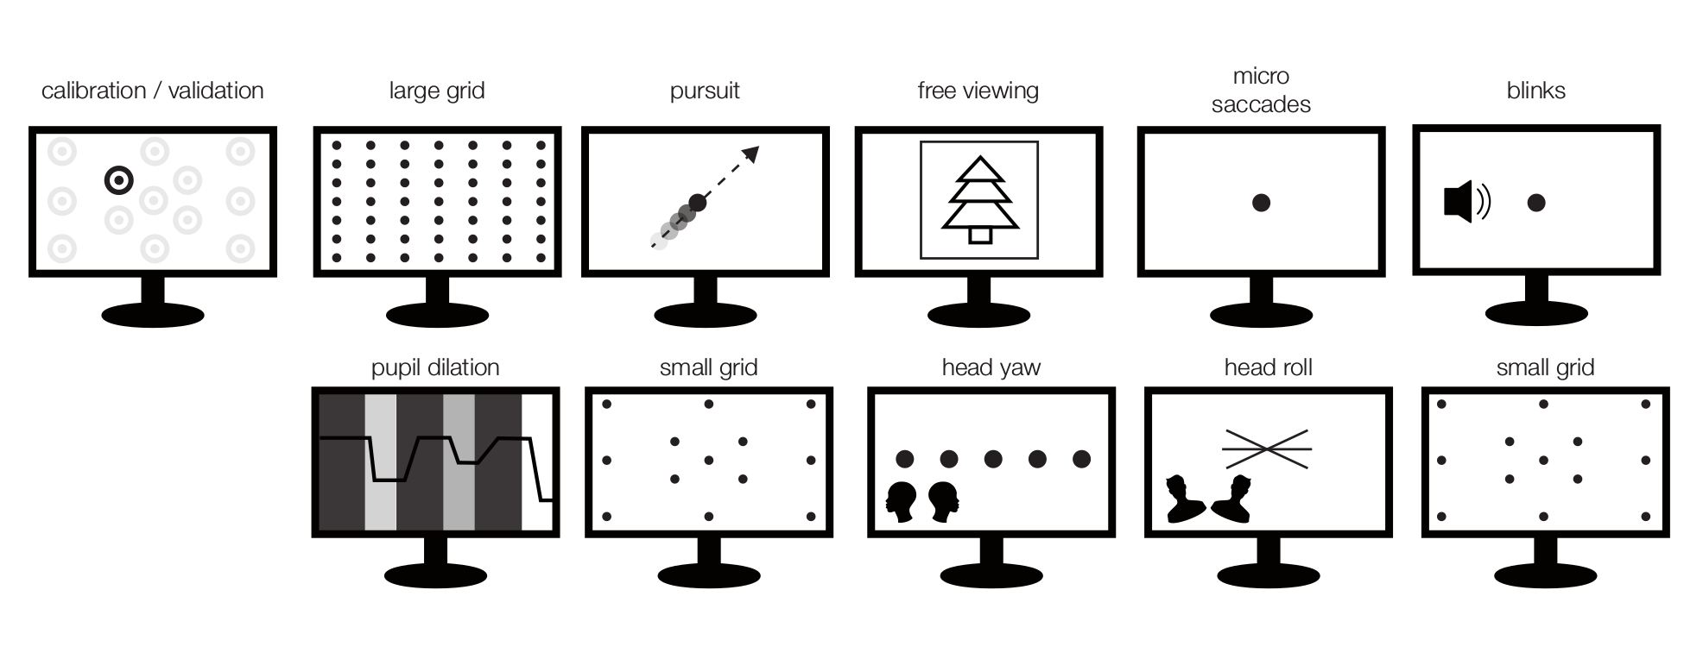
Test Battery
repeated 6 times
15 subjects
Notes:
This was the complete test battery as Bene presented last time

Slide 6
Analyzed conditions
Notes:
I will only focus on conditions,
.
that I analyzed or that are otherwise important for understanding
..
[read and explain conditions]

Slide 7
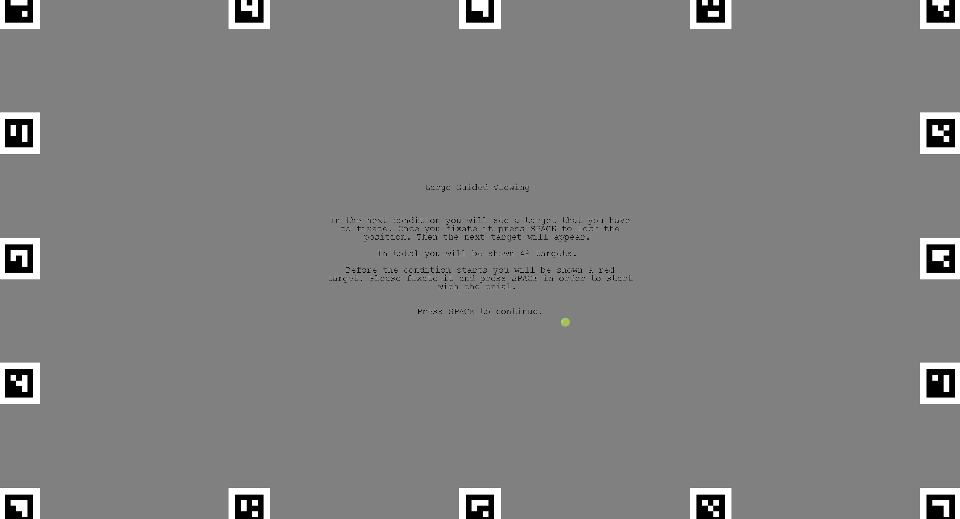
The task:
7x7 grid
Fixate on the targets
Measures:
- Variance of fixation (Accuracy)
Hypotheses:
EL accuracy ~0.5°, PL ~1-2°
Notes:
So this is the slide that you know when we presented the project some month ago.
.
So let’s see what our Hypotheses were:

Slide 8
Raw Eye Movement Data
Notes:
Grid
.
.
Only x component on y axis
.
.
Good example
.
.
Signals qualitatively seem to
have the same shape

Slide 9
Raw Eye Movement Data
Notes:
Bad example
.
Here you see that pupil labs has some difficulties at the beginning of the fixations

Slide 10
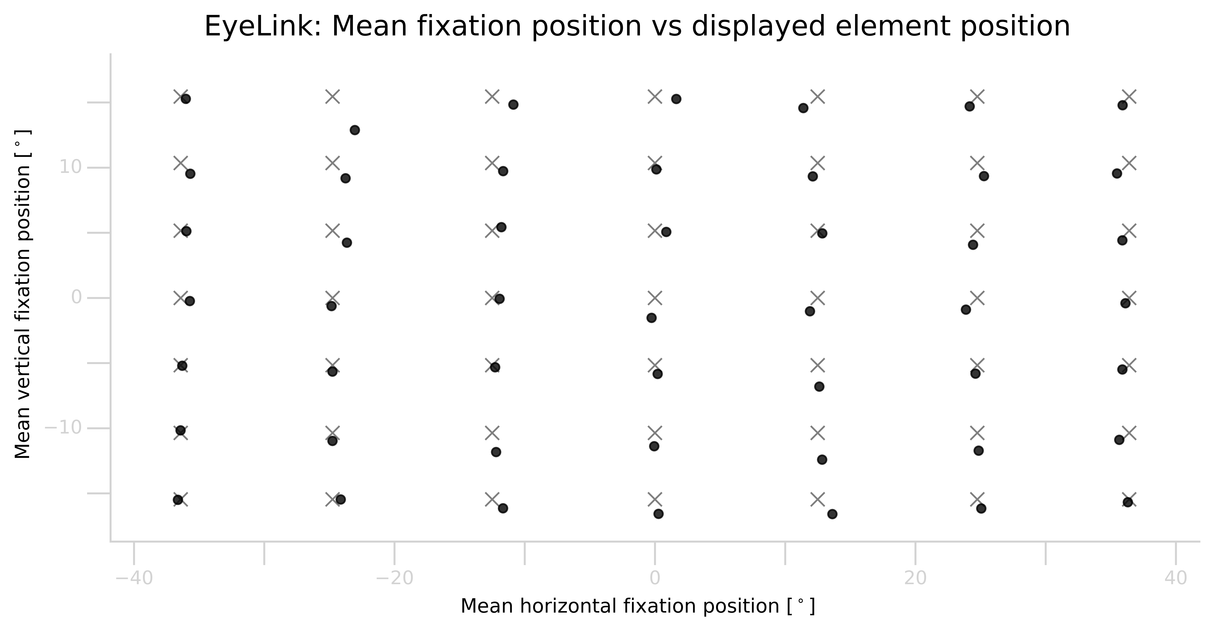
Large Grid Condition
- EyeLink subject VP25 block 2 -
Notes:
One subject - One block
.
Accuracy = difference between the estimated gaze position and the true target (we know where we displayed the fixation cross)
.
- we take the last fixation before the next displayed element
.
So when we access the accuracy of an eye tracker we want the average performance for the elements
. (→ so we take the mean over the elements).
. We want the typical performance over blocks (median).
. And then the average performance over subjects.
.
So lets have a look at our results

Slide 11
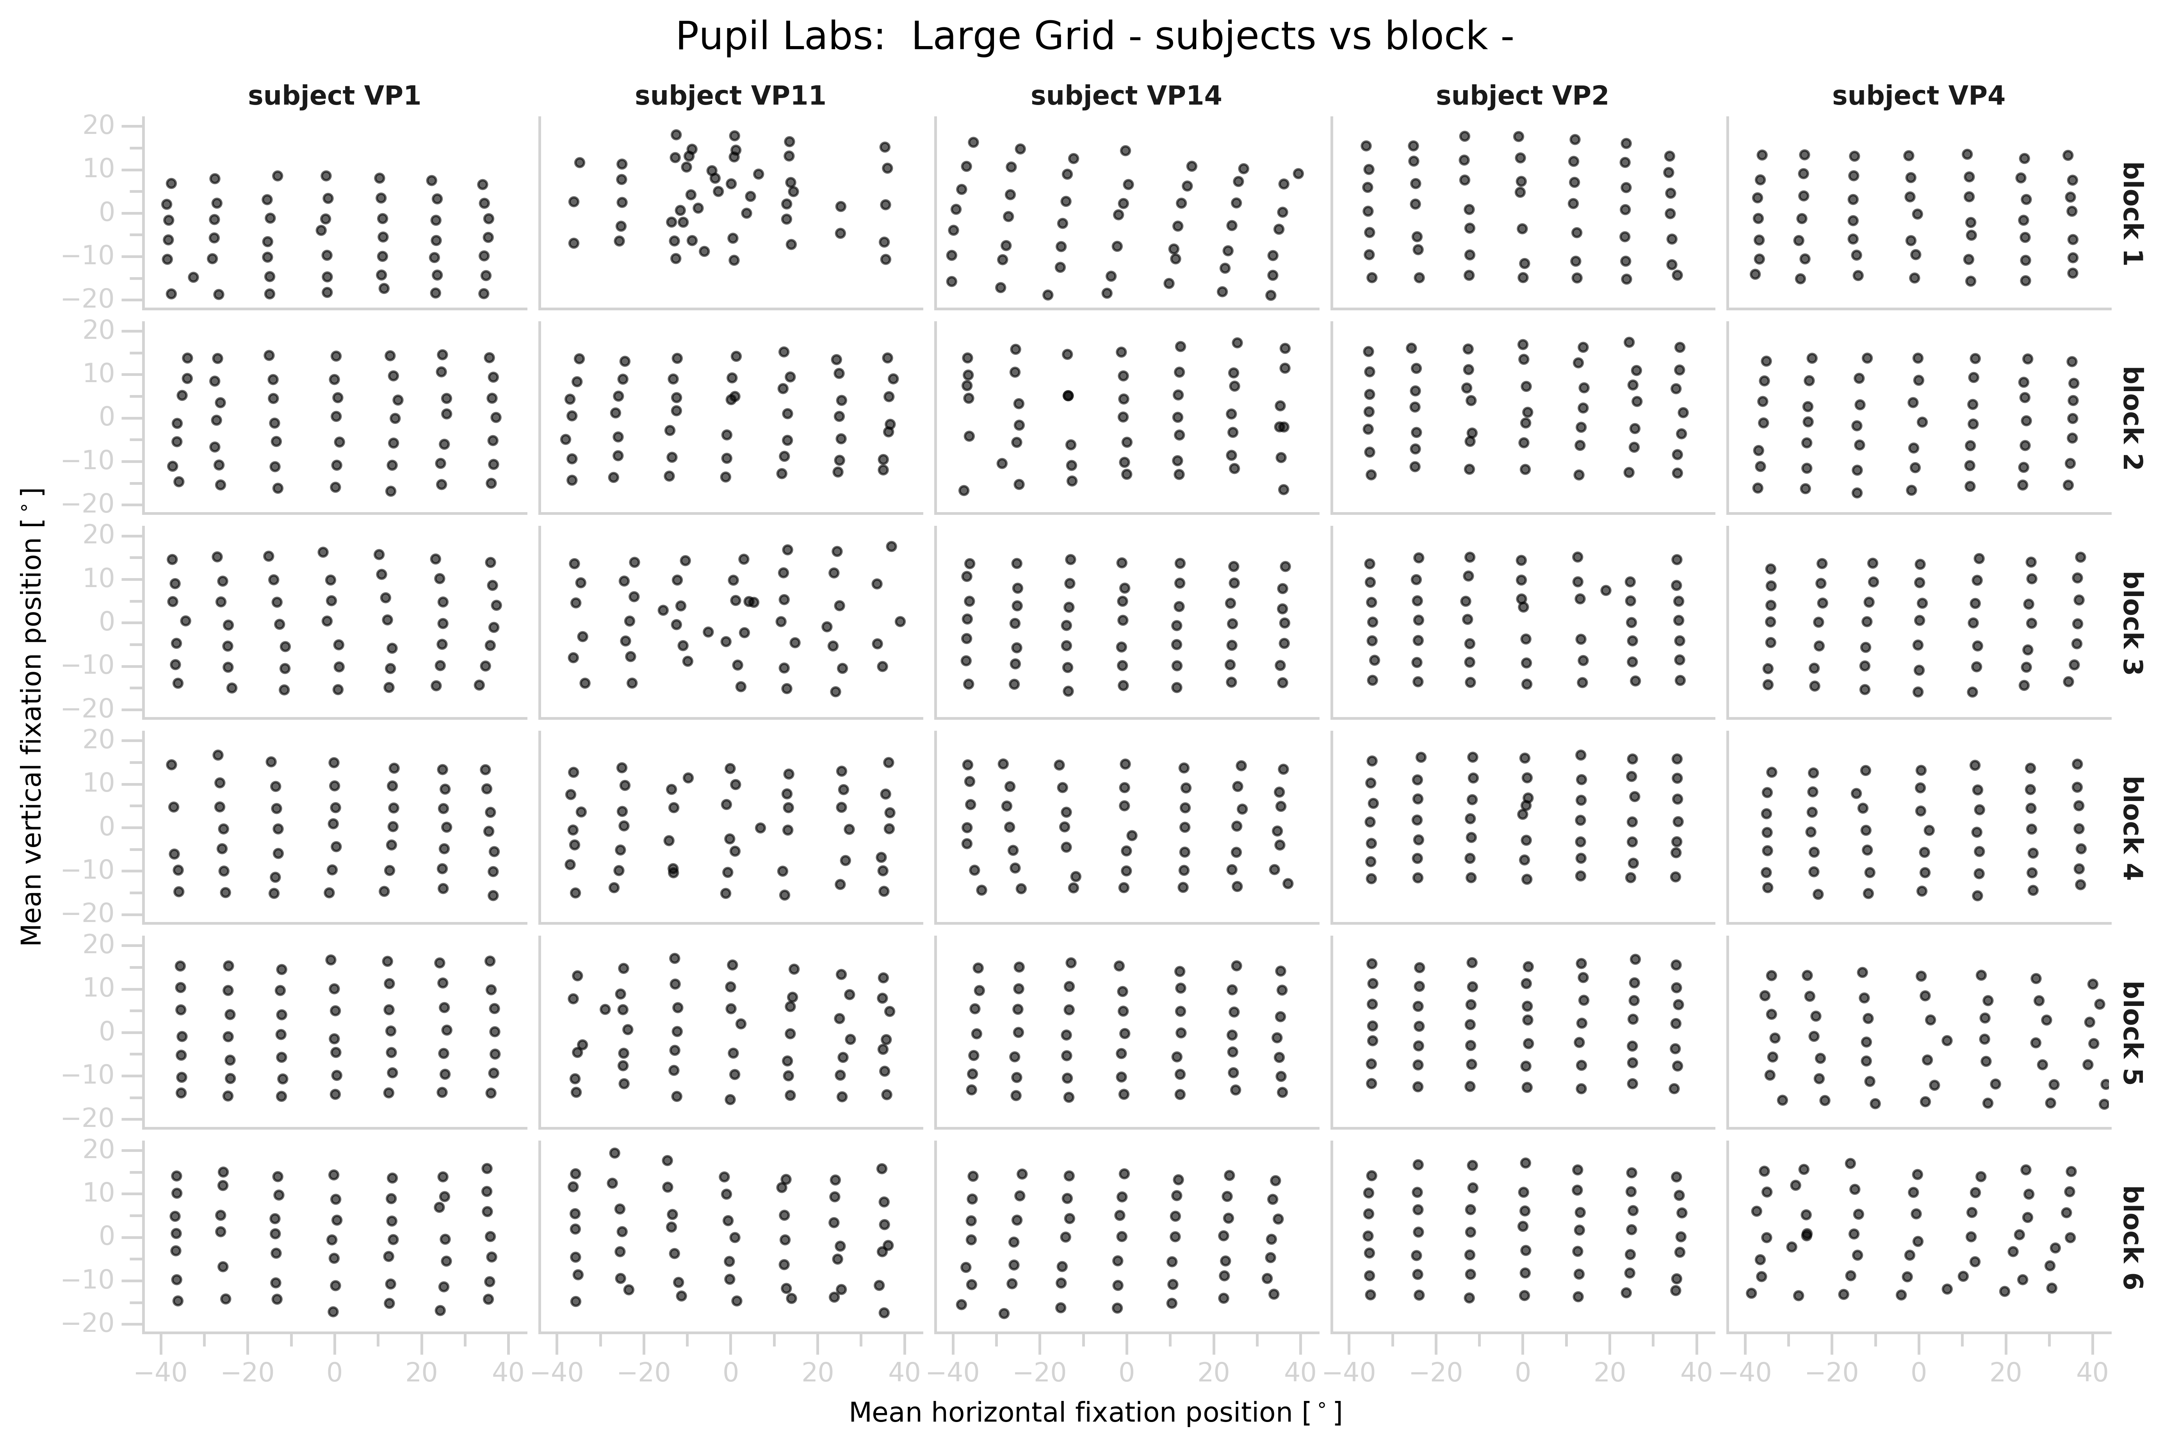
Large Grid Condition
Notes:
Point out:
- generally good
- there are subjects that are difficult to track
- there are subjects that are difficult to track with a certain eye tracker
- there are blocks where the gaze estimation is totally off

Slide 12
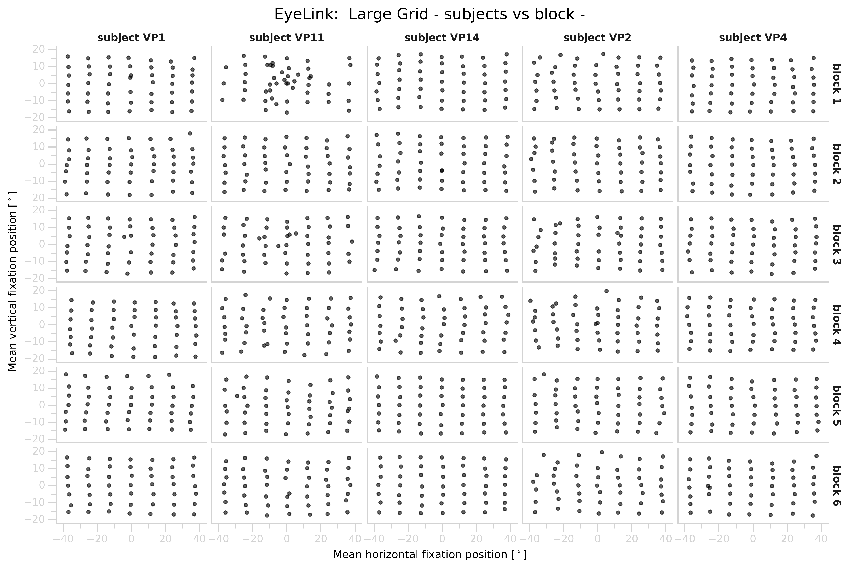
Large Grid Condition

Slide 13
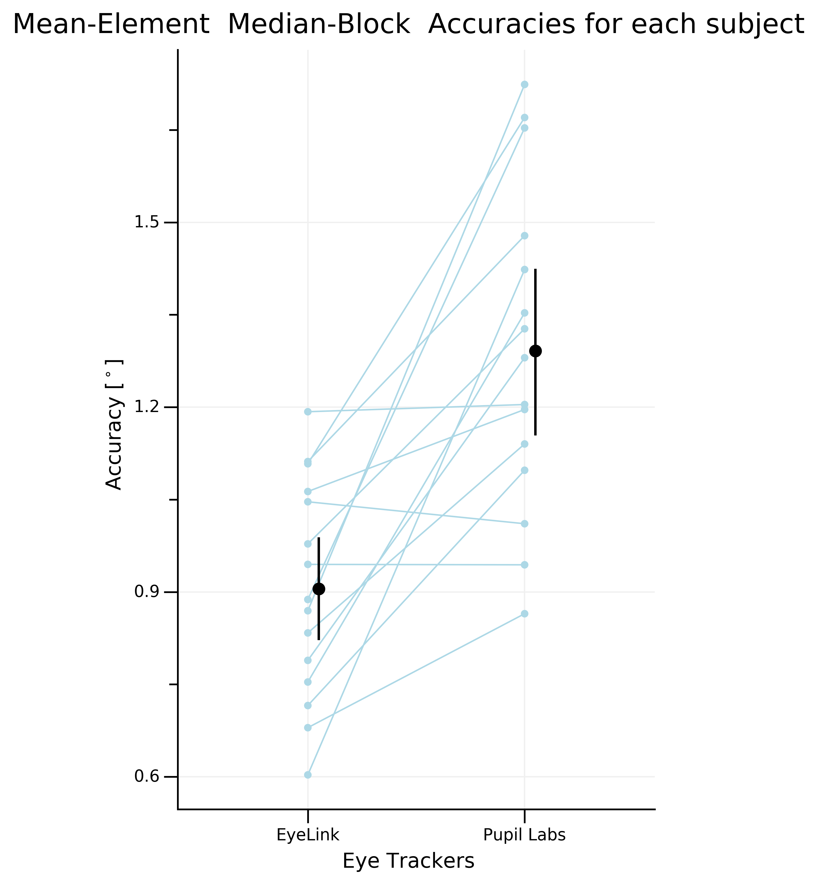

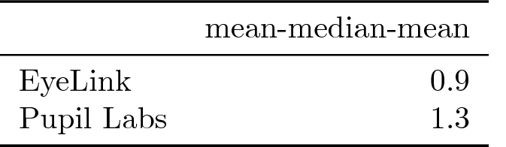
Large Grid Condition
EyeLink performs
surprisingly bad
Pupil Labs performs
surprisingly good
Notes:
Each blue dot is a subject
.
.
[read out conclusion]

Slide 14
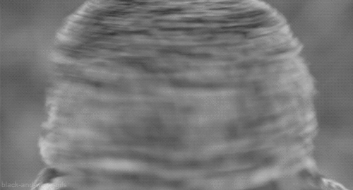
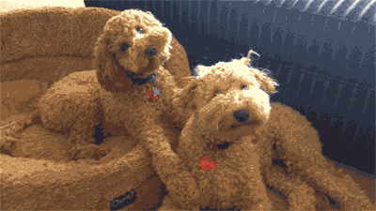
The task:
Fixate on the targets
Measures:
- Accuracy before & after head motion
Hypotheses:
Worse accuracy after headmovement
Notes:
So this is the slide that you know when we presented the project some month ago.
.
So let’s see what our Hypotheses were:

Slide 15
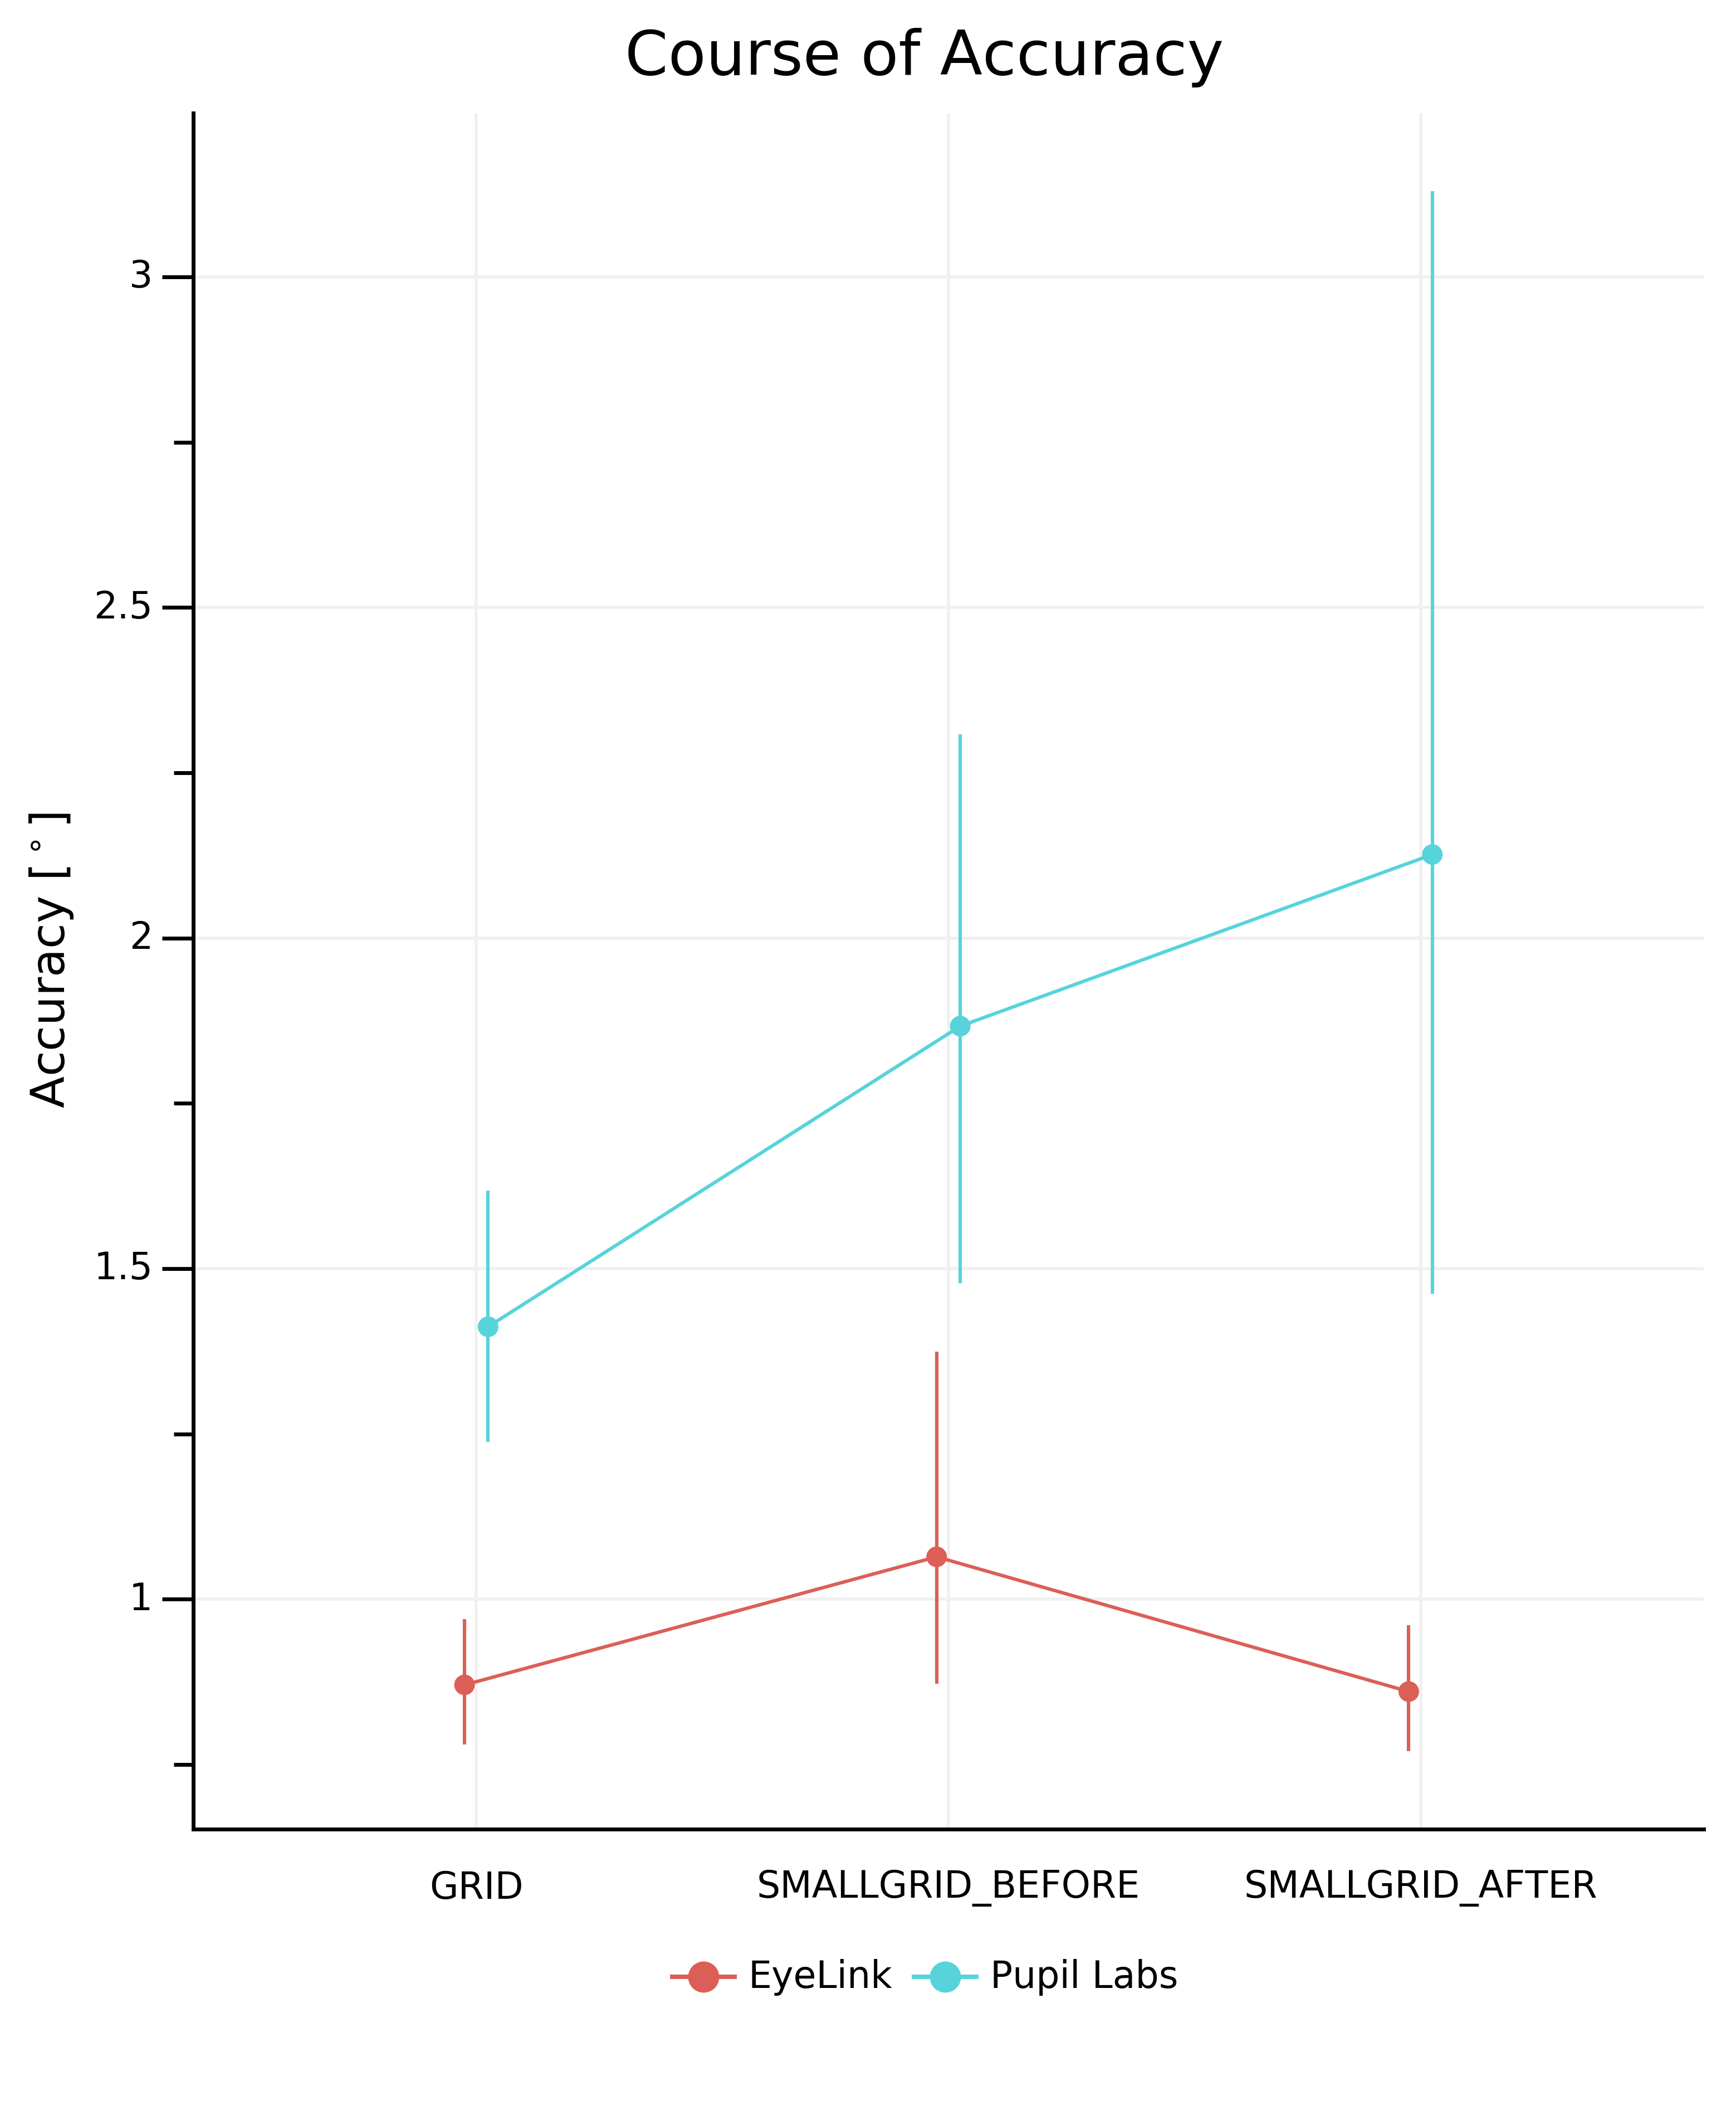
Large & Small Grid Condition
Notes:
So we see the trend of accuracy
.
CHANGE of Accuracy throughout the experiment in grid conditions based on 13 elements
.
.
We expected:
.
But Not as expected
.
- we dont know why
.
- ideas?

Slide 16

The task:
3 images / block
6 seconds / image
Measures:
- Central fixation bias
- Number of fixations
- Fixation durations
Hypotheses:
- none -
Notes:
So this is the slide that you know when we presented the project some month ago.
.
So let’s see what our Hypotheses were:

Slide 17
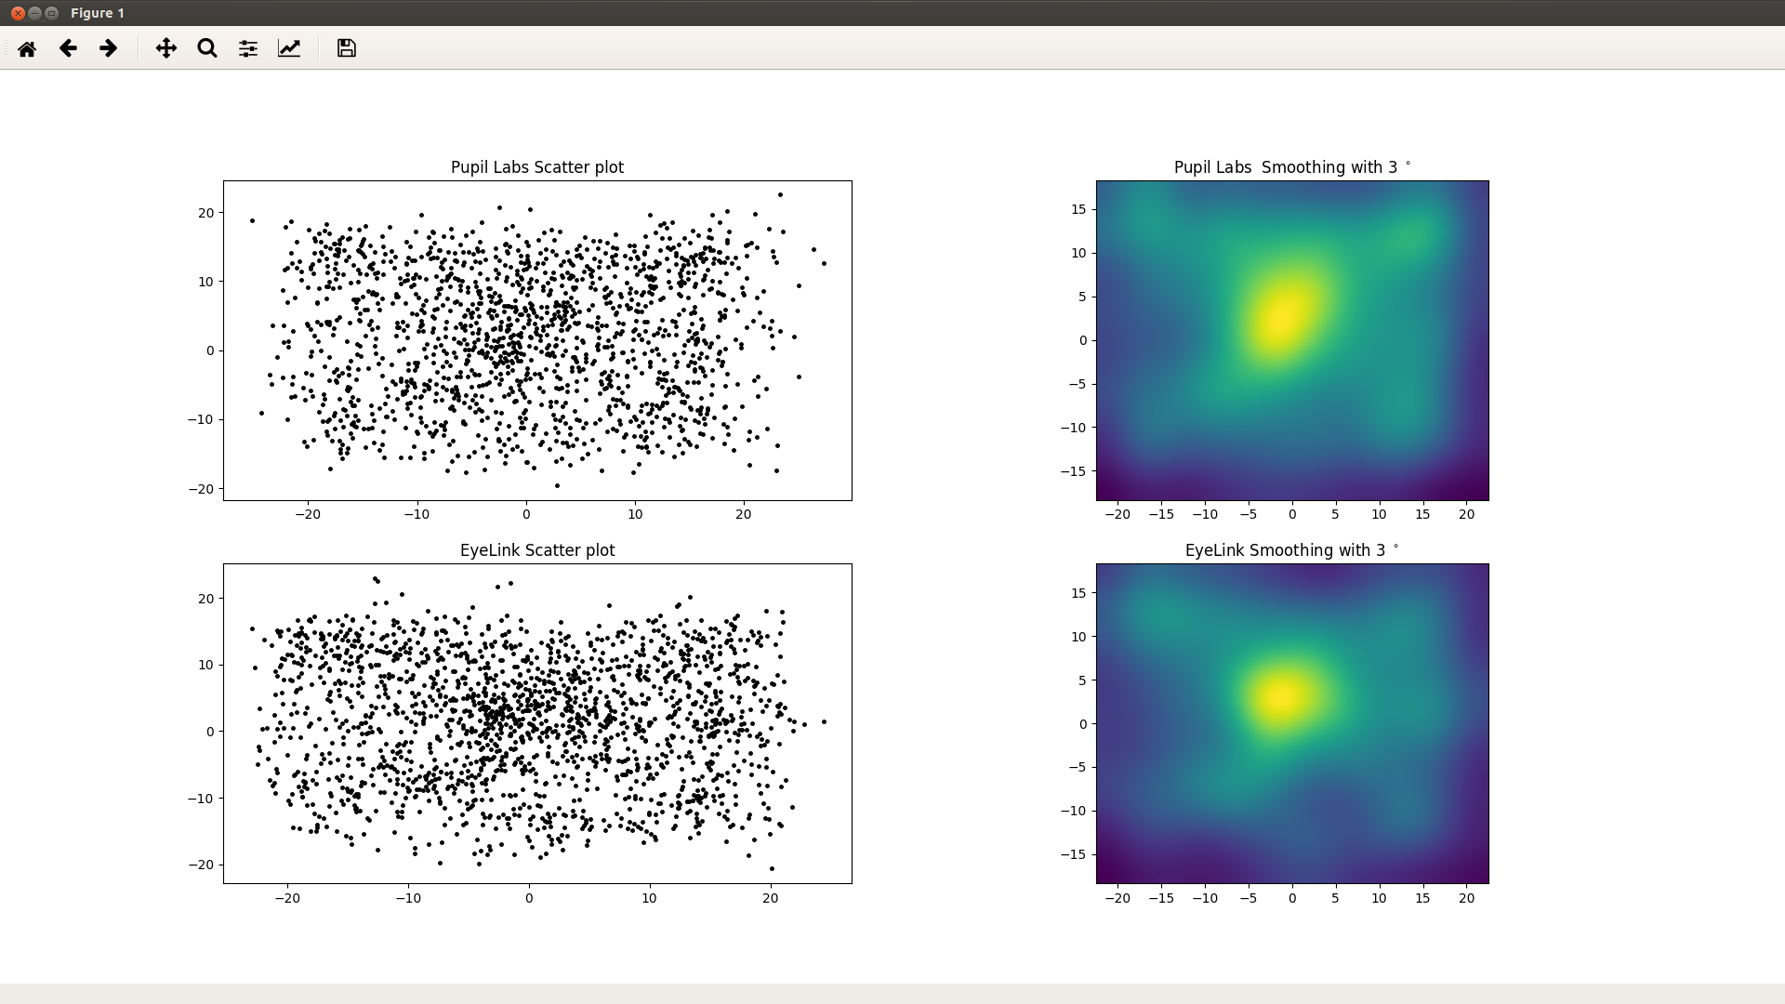
Freeviewing
- Central Fixation Bias -
Notes:
The central fixation bias describes
the tendency to fixate the center of the screen when viewing scenes on computer monitors.
.
We can see the heatmap visualizing the amount of fixations.
.
- similar but also unarguably different.
.
- but it is hard to compare heatmaps,
.
So let’s look at the number of fixation and the fixation durations.

Slide 18
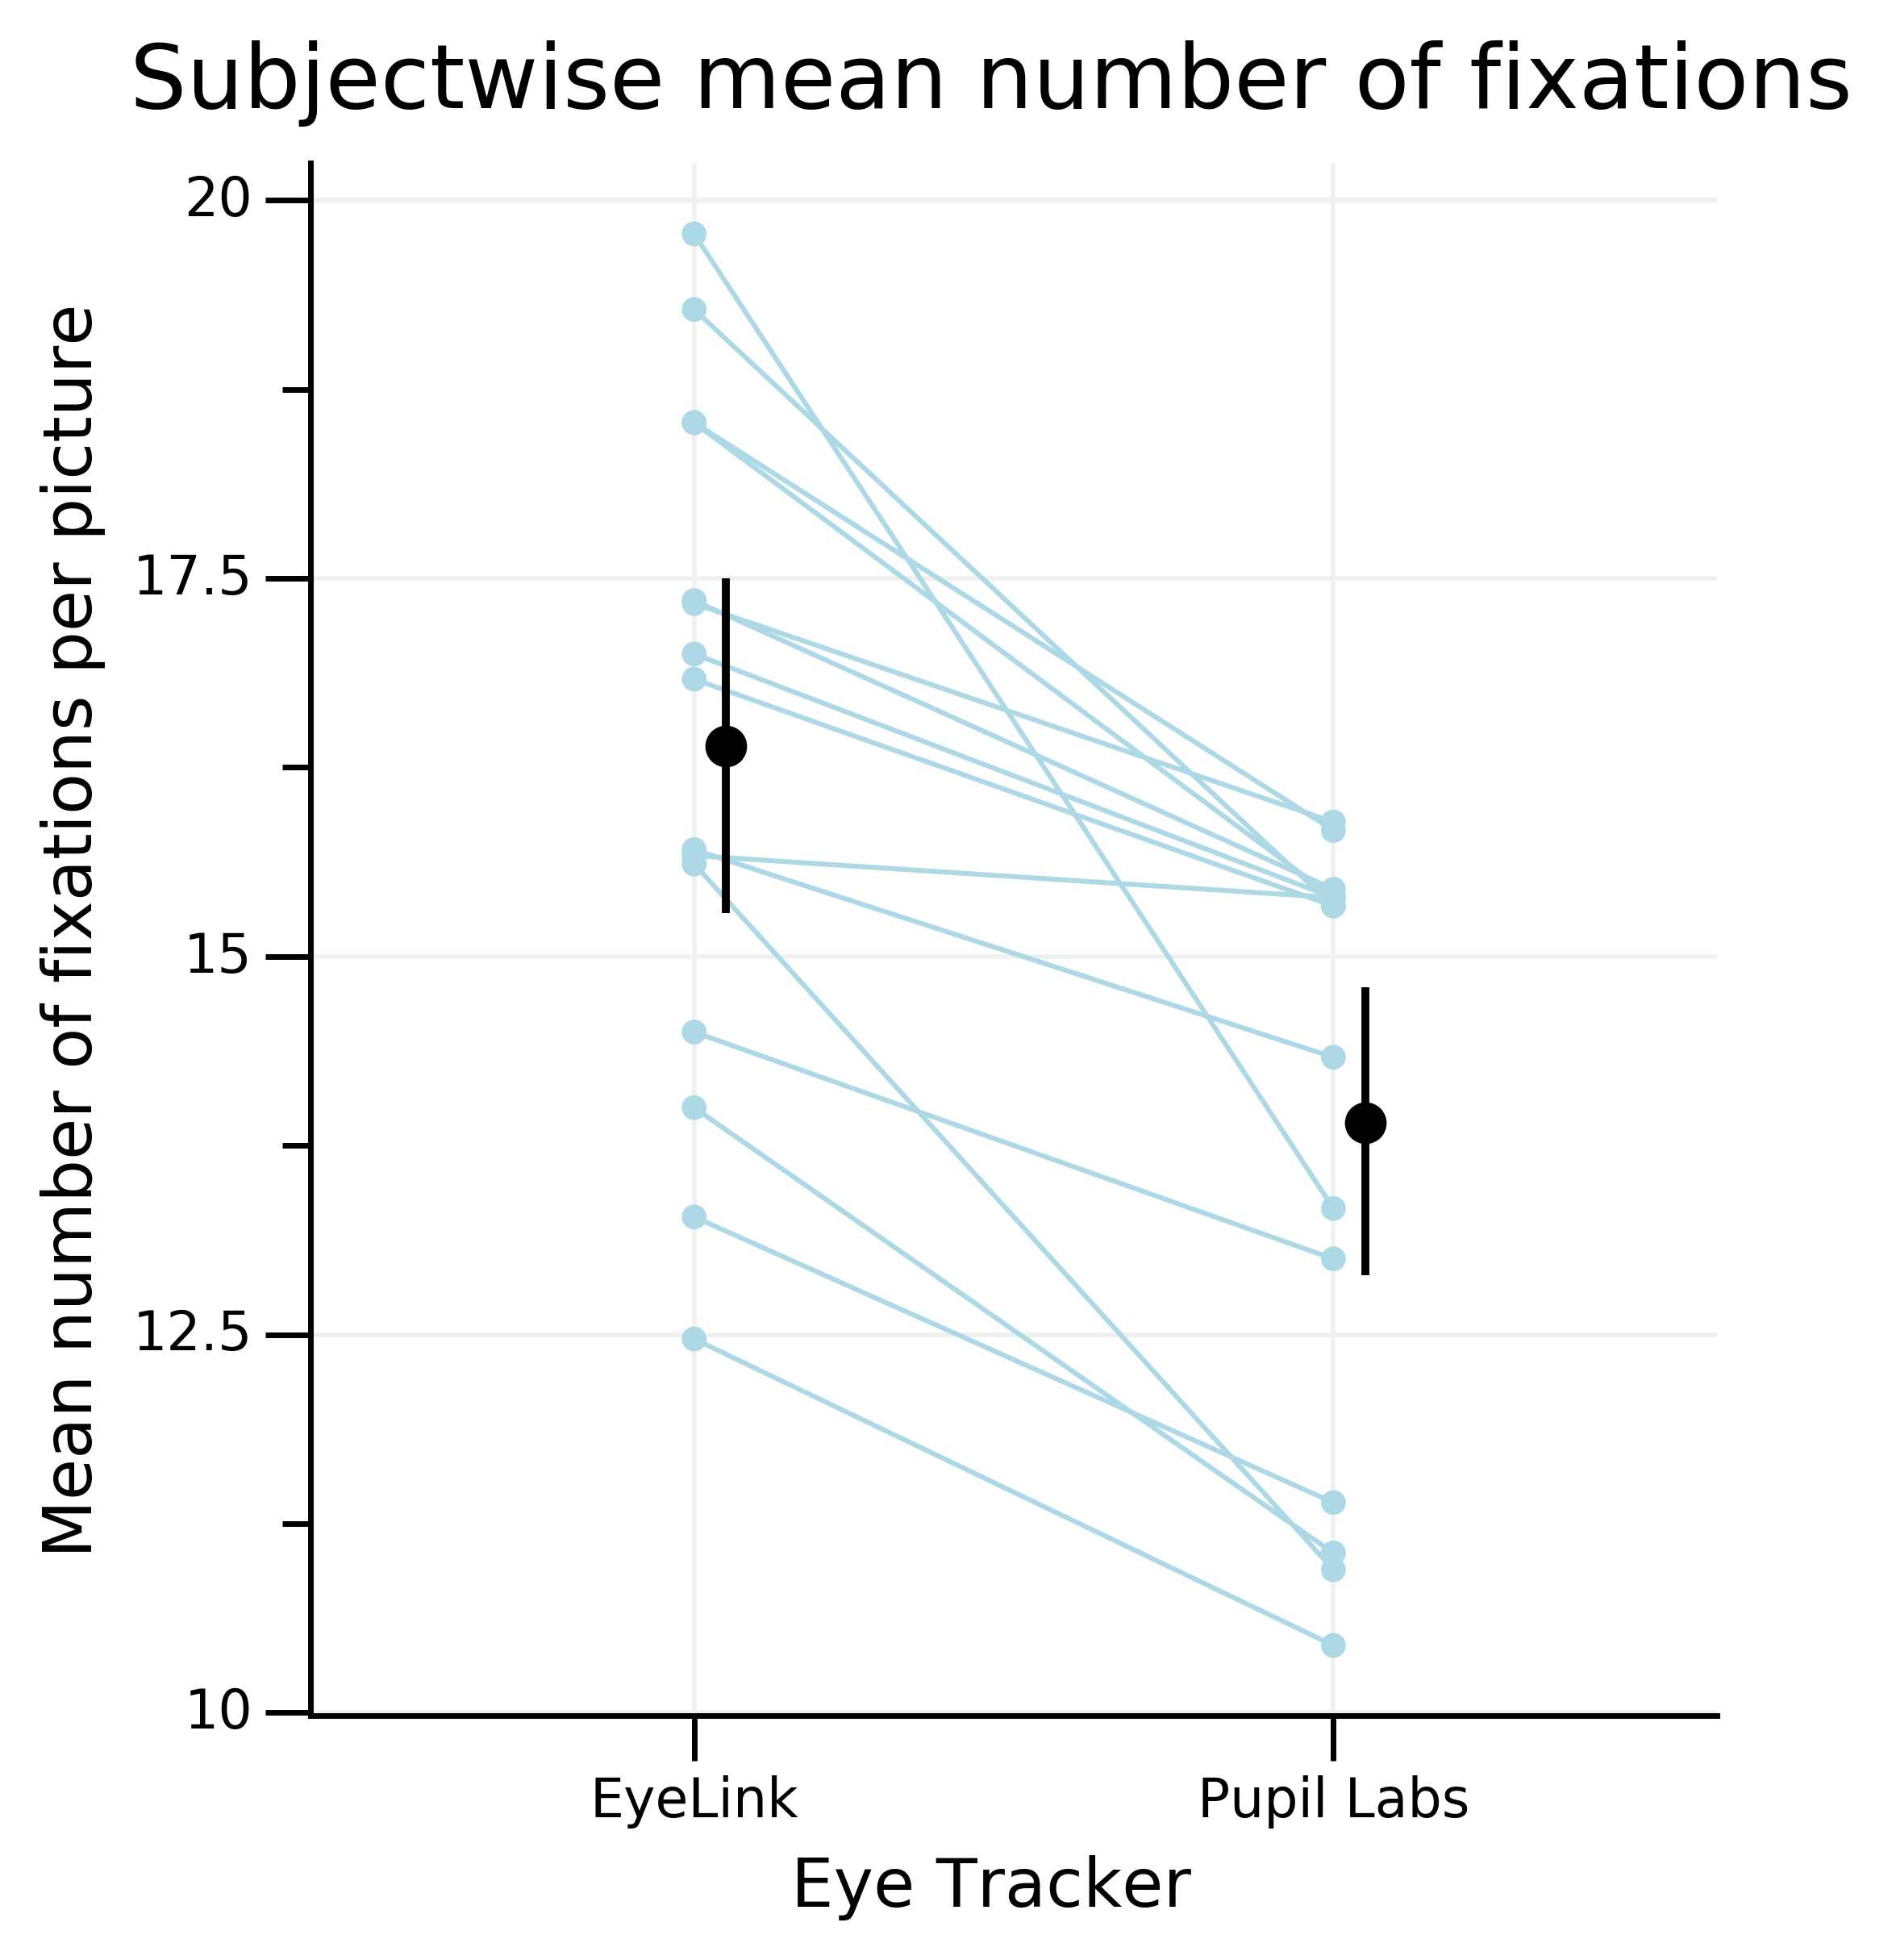
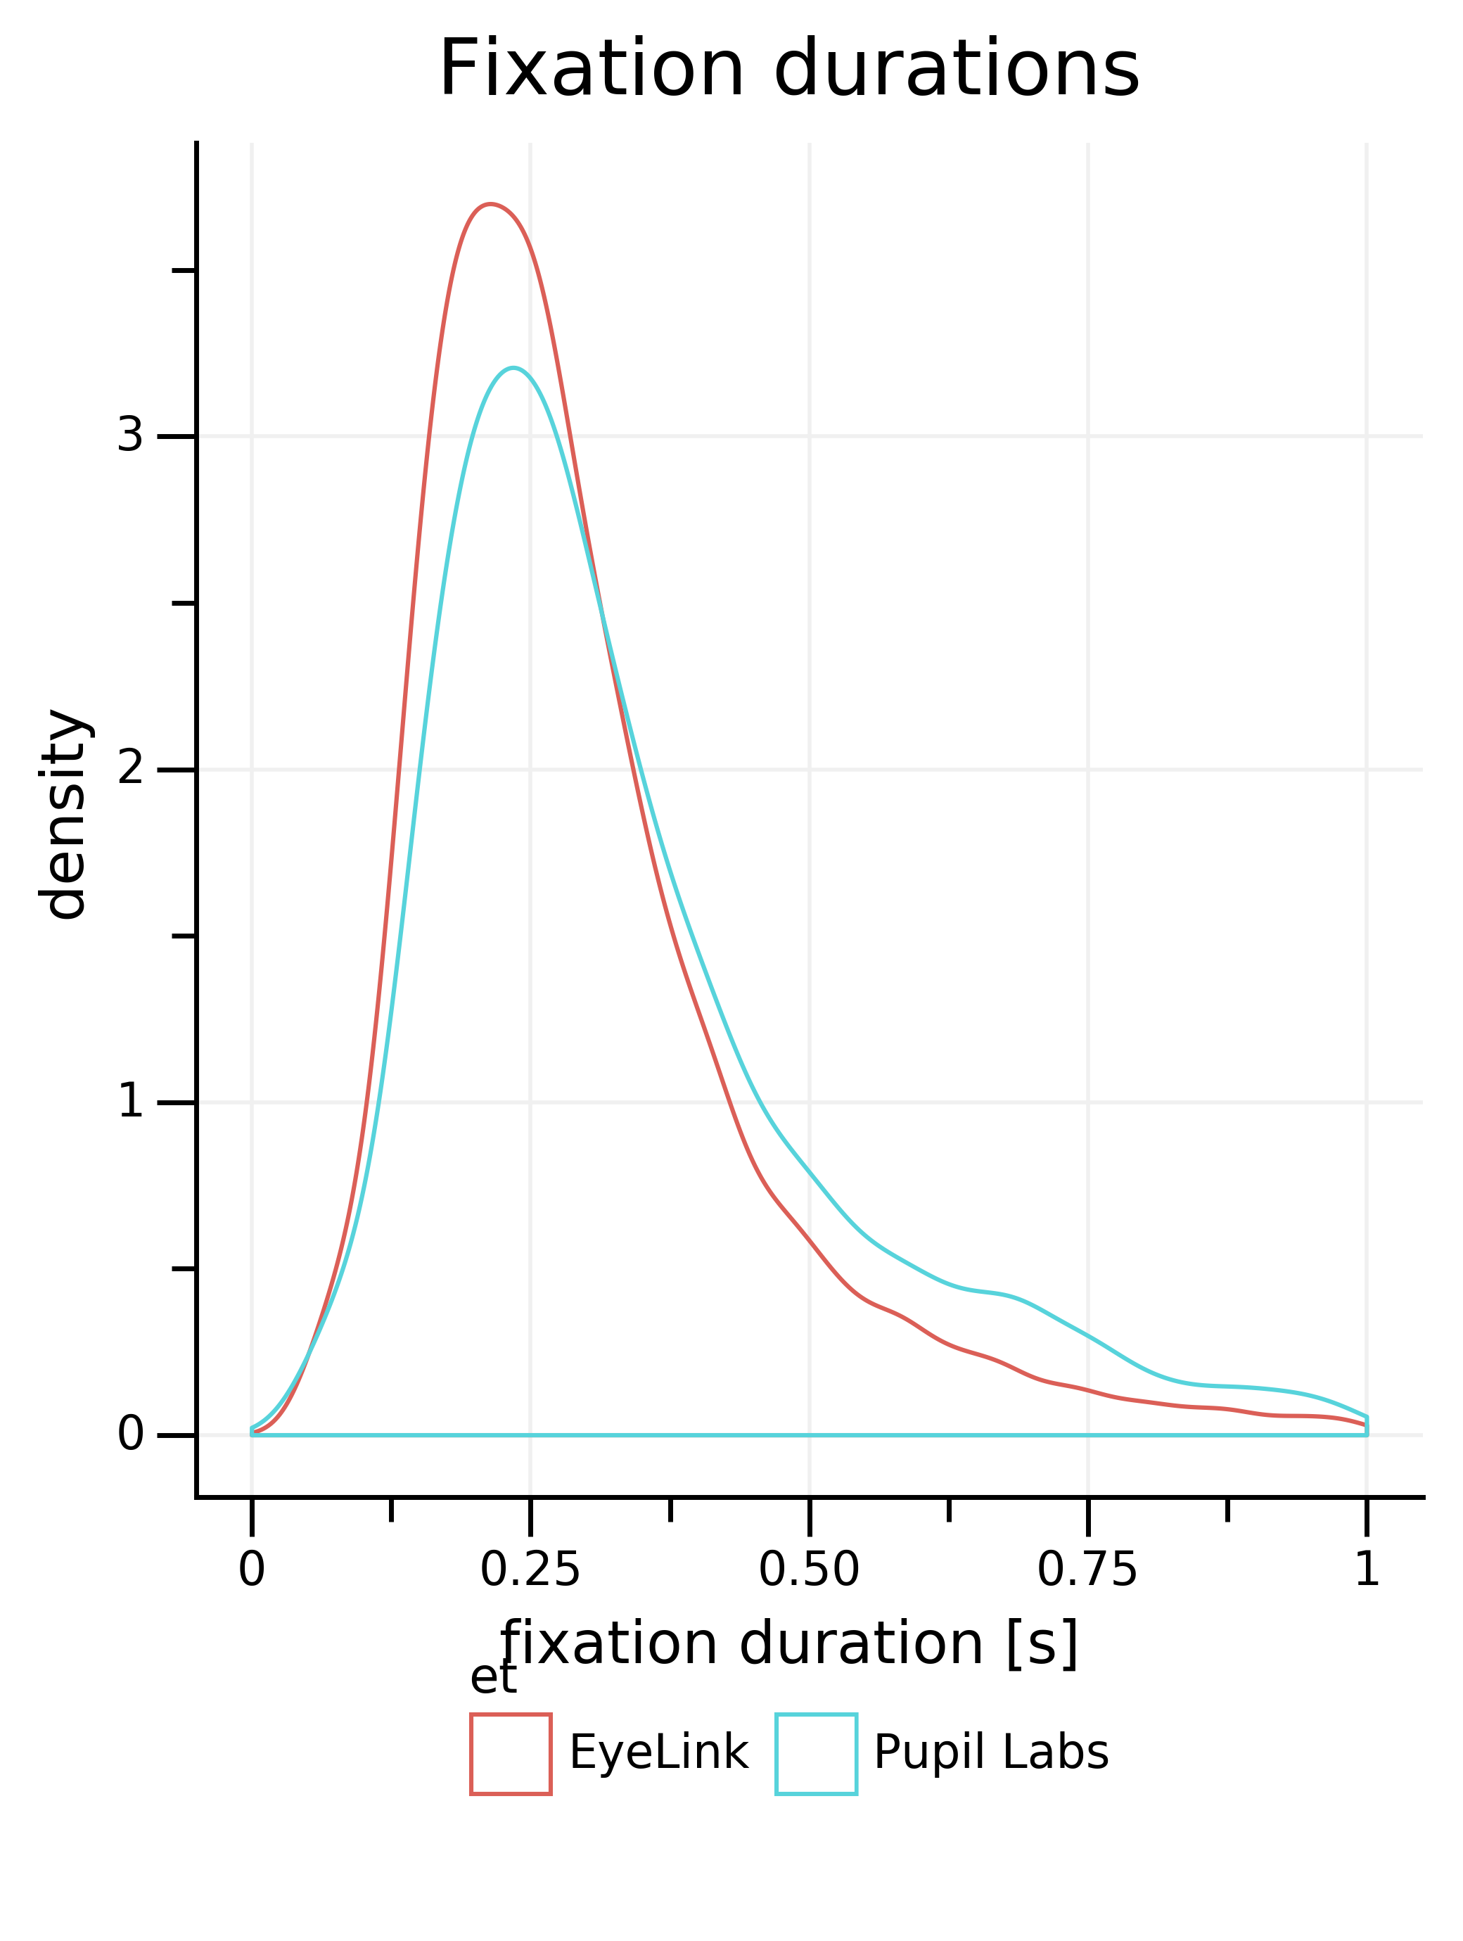
Freeviewing
Notes:
- number mean number of fixation for one picture per subject
.
- EyeLink detects more fixations
.
- Caution: this is very dependend on the algorithm
.
.
- density curved: area normalized to 1
.
- EyeLink has more shorter fixations
.

Slide 19
Take-home message
Don’t trust accuracies reported my the manufacturers blindly!³
    don’t count on better mean performance than:
    ~ 0.9° for EyeLink and ~ 1.3° for Pupil Labs
    qualitative agreement of raw signal is surprisingly good
    mind interactions between eyetrackers and detection algorithms
Notes:
- think about inaccurate gaze data when designing your experiment
.
- accuracy for pupil labs is around and degrees for eyelink under lab conditions
.
We were surprised. But also another study
shows EyeLInk accuracy around 1 degrees.
.
- Eye Tracker macht einen großen Unterschied
.
ET kann man aussuchen, subject nicht

Slide 20
Thank you!
Notes:
So there is still a lot of work left and I appreciate any comments and help.
.
I also want to use this opportunity to say thank you to Bene, Inga and Peter for allowing me to join the etcomp team.
.
.
Thank you for your attention
.
.
Questions?

Slide 21
References
¹ Kassner, M., Patera, W., & Bulling, A. (2014). Pupil: An Open Source Platform for Pervasive Eye Tracking and Mobile Gaze-based Interaction. ArXiv:1405.0006 [Cs]. Retrieved from http://arxiv.org/abs/1405.0006
² SR Research. (n.d.). The EyeLink® 1000 Plus Eye Tracker. Retrieved from https://www.sr-research.com/wp-content/uploads/2017/07/EyeLink-1000-Plus-Brochure-2016-November.pdf
³ Holmqvist, K. (2016). Common predictors of accuracy, precision and data loss in 12 eye-trackers
Notes:
In the tea time you should have 20 min for presentation and 10 min for discussion
.
.
| | Pupil Labs | EyeLink 1000 |
|-----------------------|--------------|-----------------|
| accuracy | 0.6&deg; | 0.25 - 0.5&deg; |
| temporal resolution | 120 Hz | 500 Hz |
| principle | binocular recording | monocular recording |
| | EyeLink 1000 | Pupil Labs |
|------------------------------------|-----------------------------------|-------------------------------|
| accuracy (value from manufactorer) | 0.25 - 0.5 degree of visual angle | 0.6 degree of visual angle |
| precision | 0.01 degree RMS | 0.08 degree RMS |
| temporal resolution | 1000 Hz | 120 Hz |
| principle | monocular | binocular |
| method | Dark Pupil Corneal Reflection | Dark Pupil Corneal Reflection |
| pupil detection | Ellipse fitting | Pupil Labs |
| | | |d

